Slide 1

Hy!

Slide 2
- Cinema Reservation Web App -
Register accounts;
Log in [Admin/User]
Dynamic movie info from Movie DB API
Admin can do CRUD operations;
User can reserve a ticket;
MySQL DB connection;

Slide 3
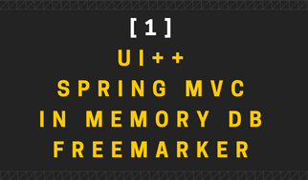
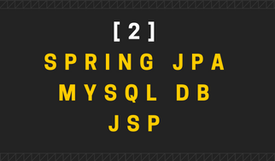

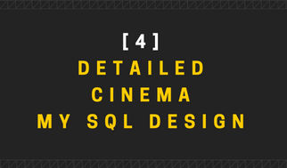

Slide 4
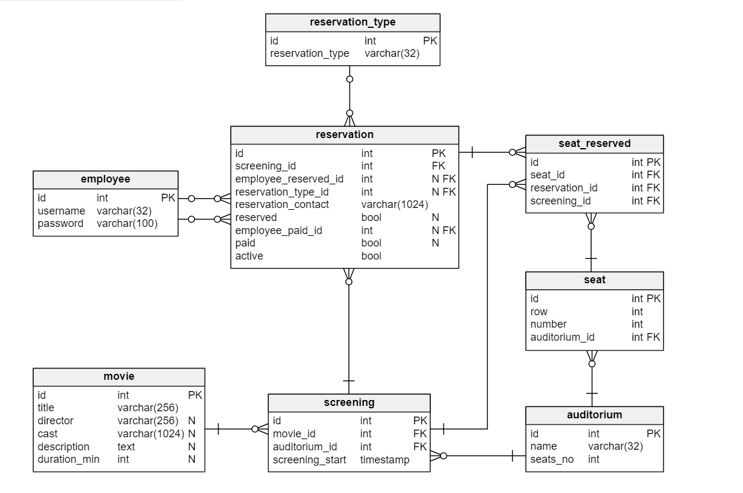

Slide 5
- Current status of App-
90%
75%
50%
5%
UI
ENTITIES & DAO
DB
MERGE
I only need to do ticket printing.
I have the design, still need to do link with java.
Still need to merge all componets together.
Hello everyone! Just a sneak peek of the project.

Slide 6

DAR INAINTE DE:
TREBUIE SA SPUN CA…

Slide 7

CHIAR DACA
UN ASTEROID
AR CADEA
PE PAMANT

Slide 8





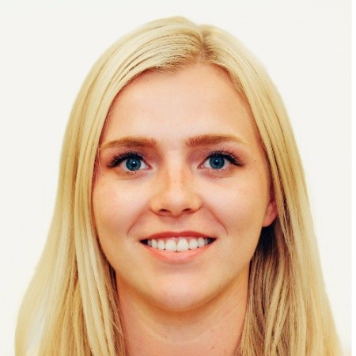

NOI TOT V-AM DATORA, UN MARE,
THANK YOU!
Liviu
Alin
Bunicu
Silviu
Vlad
Andreea
Ciprian

Slide 9
NOI TOT V-AM DATORA, UN MARE,
THANK YOU!
Liviu
Alin
Bunicu
Silviu
Vlad
Andreea
Ciprian

Slide 10
MULTUMIM!

